Slide 1
Martin Street Boundary Review Feedback Form Review

Slide 2
General Information
132 responses
Common themes were:
Adding more students to schools for better programs.
Bussing being too far.
Overcrowding at Escarpment View.
Scenario 12b and 12c being able to balance out the students.
Allowing students to stay at their current school until graduation
Grandparenting
Students moving too many times

Slide 3
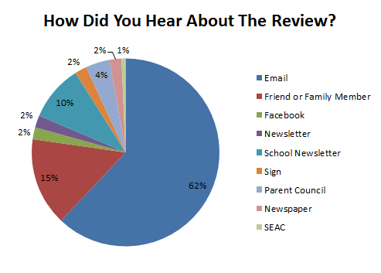
Where Did You Hear About The Review?
90 from email
22 from a friend or family member
14 from the school newsletter
6 from parent council
3 facebook
3 from newsletter
3 from school signs
3 from the newspaper
1 from SEAC

Slide 4
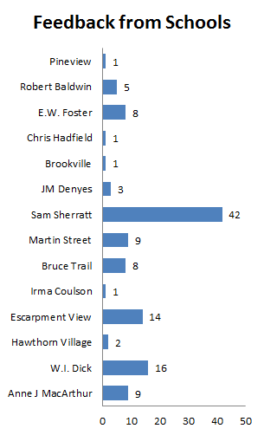
Responses From Schools
The Majority of responses were from Sam Sherratt parents in the Triangle

Slide 5
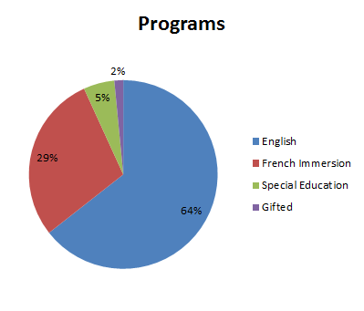
Programs Affected
85 English
38 French Immersion
7 Special Education
2 Gifted

Slide 6
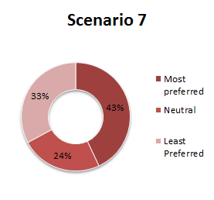
Scenario 7 Data
55 liked it
31 were neutral
42 disliked it
Martin St PS opens Sept 2017 as a JK‐7 ENG and 2‐7 FI school, grade 8 ENG and FI added Sept 2018

Slide 7
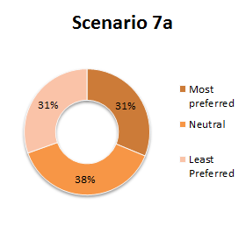
Scenario 7a Data
40 liked it
49 were neutral
39 disliked it
Martin St PS opens Sept 2017 as a JK‐6 ENG and 2‐6 FI school, grade 7 ENG and FI added Sept 2018, grade 8 ENG and FI added Sept 2019

Slide 8
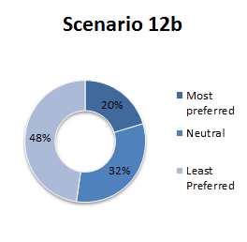
Scenario 12b Data
26 liked it
41 were neutral
61 disliked it
Martin St PS opens Sept 2017 as a JK‐6 ENG and 2‐6 FI school, grade 7 ENG and FI added Sept 2018, grade 8 ENG and FI added Sept 2019
JM Denyes grade 5 ENG feeds into WI Dick
Sam Sherratt 'triangle' (James Snow Pkwy/Cedar Hedge Rd) will attend Martin St PS ENG and FI instead of Sam Sherratt ENG and EW Foster/WI Dick FI

Slide 9
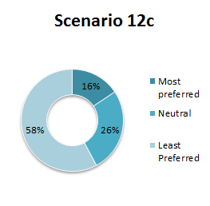
Scenario 12c Data
20 liked it
34 were neutral
74 disliked it
Similar to Scenario 12b with changes to implementation
Martin St PS opens Sept 2017 as a JK‐7 ENG and 2‐7 FI school, grade 8 ENG and FI added Sept 2018

Slide 10
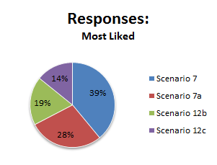
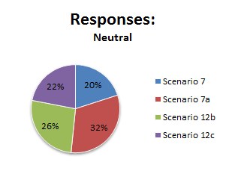
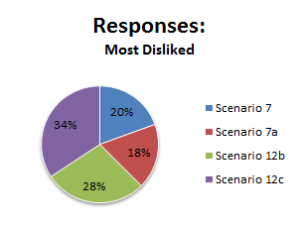
Scenario Summary
Scenario 7 was the least liked
People were neutral on Scenario 7a
Scenario 12c was the most disliked

