Slide 1
Boundary Review Committee Martin Street PS Rebuild Elementary School
Thursday, November 24, 2016
7:00 pm
Milton District High School
(Library)

Slide 2
Agenda
Introductions, agenda and materials
Purpose and desired outcomes
Roles
Boundary Review Administrative Procedure
Timelines
Selection Criteria
Scenarios and maps

Slide 3
Why A Boundary Review?
At the November 2, 2016 Board meeting, HDSB Trustees approved a motion to initiate the process to establish a boundary for Martin Street PS.
Be it resolved that the Halton District School Board direct the Director to
undertake a school boundary review for the new Martin Street PS, with an
expected completion date of no later than February 2017.

Slide 4
Purpose of Martin Street Review
The mandate of the Boundary Review Committee is to determine who will attend the new elementary school in Milton.

Slide 5
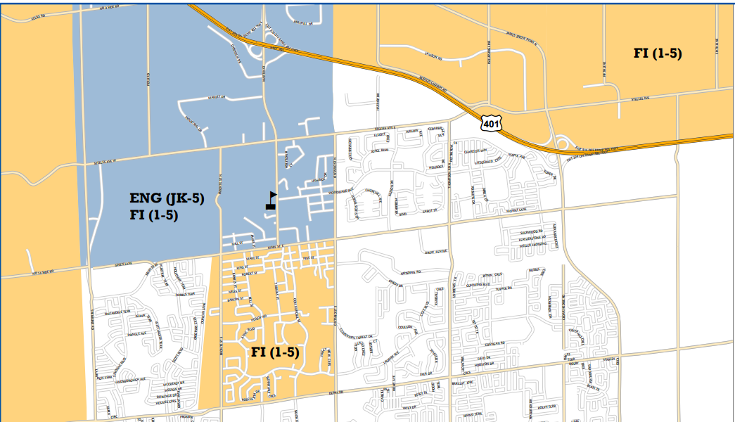
Process for Establishing Boundaries
Rural not shown

Slide 6
Role of Steering Committee
A Boundary Review Steering Committee is established to lead the school boundary review process.
review school enrolments, school capacities and school programs
determine initial scope of the study and generate initial boundary options for consideration by the larger Boundary Review Committee
ultimately make a recommendation for the Director to consider when making the final recommendation to the Board for decision

Slide 7
Boundary Review Steering Committee
Family of Schools Superintendent(s) of all affected areas
Jacqueline Newton - Chair of BRSC
Superintendent of Program
Cristina Salmina
Superintendent of Business
Lucy Veerman
Manager from Planning Department
Dom Renzella (Manager)
Laureen Choi
Mitchell Gundy
Trustees for all of the affected areas
Trustee Kim Graves
Trustee Donna Danielli
Boundary Review Committee Chair (appointed by Director)
Superintendent of Student Services
Trustee Jeanne Gray (Co-Chair of BRC)
Gord Truffen (Co-Chair of BRC)
Mark Zonneveld

Slide 8
Role of Boundary Review Committee
The BRC is established to examine the initial options generated by the Boundary Review Steering Committee and to have the opportunity to give feedback.
it will use criteria to measure the impact and effectiveness of boundary options.
will review the options generated by the BRSC and will offer suggestions/revisions or suggest new options to be considered
consult the community regarding the recommended option(s).

Slide 9
Parent Representation on BRC
TWO representatives from each school to serve on the Boundary Review Committee (BRC).
This will most likely be the School Council Members
To ensure consistency in membership, alternates may not be sent in place of absent members.
Meetings are open to public

Slide 10
Boundary Review Process
STEP 1 Boundary Review Steering Committee (BRSC) consisting of Board staff and trustees review enrolments, school capacities and programs. Initial boundary scenarios are generated.
STEP 2 Boundary Review Committee (BRC) established, consisting of members of the BRSC and representatives from the affected school communities.
STEP 3 Boundary Review Steering Committee develops scenarios, and shares scenarios with the BRC for information and feedback.
‹#›

Slide 11
STEP 4 Boundary Review Committee reviews scenarios and considers revisions, and makes suggestions to the Boundary Review Steering Committee.
STEP 5 BRSC undertakes public information meeting to solicit feedback and input on the boundary scenarios.
STEP 6 BRC and BRSC review the feedback and input on scenarios.
STEP 7 Boundary Review Steering Committee makes recommendation to the Director. Director takes recommended option to Trustees and/or may revise the recommended option prior to taking it to Trustees. Delegations to the Board occur within the timelines for the boundary review process. Board of Trustees make the final decision.
‹#›

Slide 12
Product Goals
The BRC is established to examine the initial options generated by the Boundary Review Steering Committee and to have the opportunity to give feedback.
it will use criteria to measure the impact and effectiveness of boundary options.
will review the options generated by the BR Steering Committee and will offer suggestions/revisions or suggest new options to be considered
will decide to either inform the community of the recommended option(s) or to consult the community regarding the recommended option(s).

Slide 13
Process Goals
That we ensure a process that is fair and transparent
That all members are heard and respected
That our discussions focus on what is best for all students
Our final recommendations will be developed through a consensus process

Slide 14
Tentative Timelines
BRC Meetings Nov. 24 (7 pm)
Dec. 6 (7 pm)
Dec. 20 (7 pm)
Jan. 10 (7 pm)
Jan. 24 (7 pm)
Public Consultation Jan. 17 (7 pm)
Admin Council Meeting Jan. 30
Board Meeting for information Feb. 15
Board Meeting for decision March 1

Slide 15
Criteria to Measure Impact & Effectiveness of Boundary Options
Possible criteria could include but is not limited to:
Criteria (could include but should not be limited to the following)
● Viability of Program – How many students are required to offer and maintain program in an educationally sound and fiscally responsible way?
● Proximity to schools -- Are opportunities for walk-to schools being maximized, school routes safe, and natural boundaries incorporated into the proposed options?
● Portables and Portapaks -- Are students being accommodated in permanent facilities and is the use of portable classrooms minimized in the proposed options?
● Balance of overall enrolment -- Is student access to programs, resources and extracurricular opportunities being maximized? Is over and underutilization of buildings avoided to the extent possible?
● Stable, long-term boundaries -- Do the projections show long term stability and result in avoiding the need for additional boundary changes in the short term?
● Transportation -- Does the option demonstrate cost effective transportation?
● Fiscally Responsible -- Does the option strive to reduce unnecessary costs?
● Student Experience -- Does the option demonstrate an effort to reduce the number of school moves students have experienced? Are cohorts kept together?
● Other -- Any other criteria recommended by the Boundary Review Steering Committee or Boundary Review Committee

Slide 16
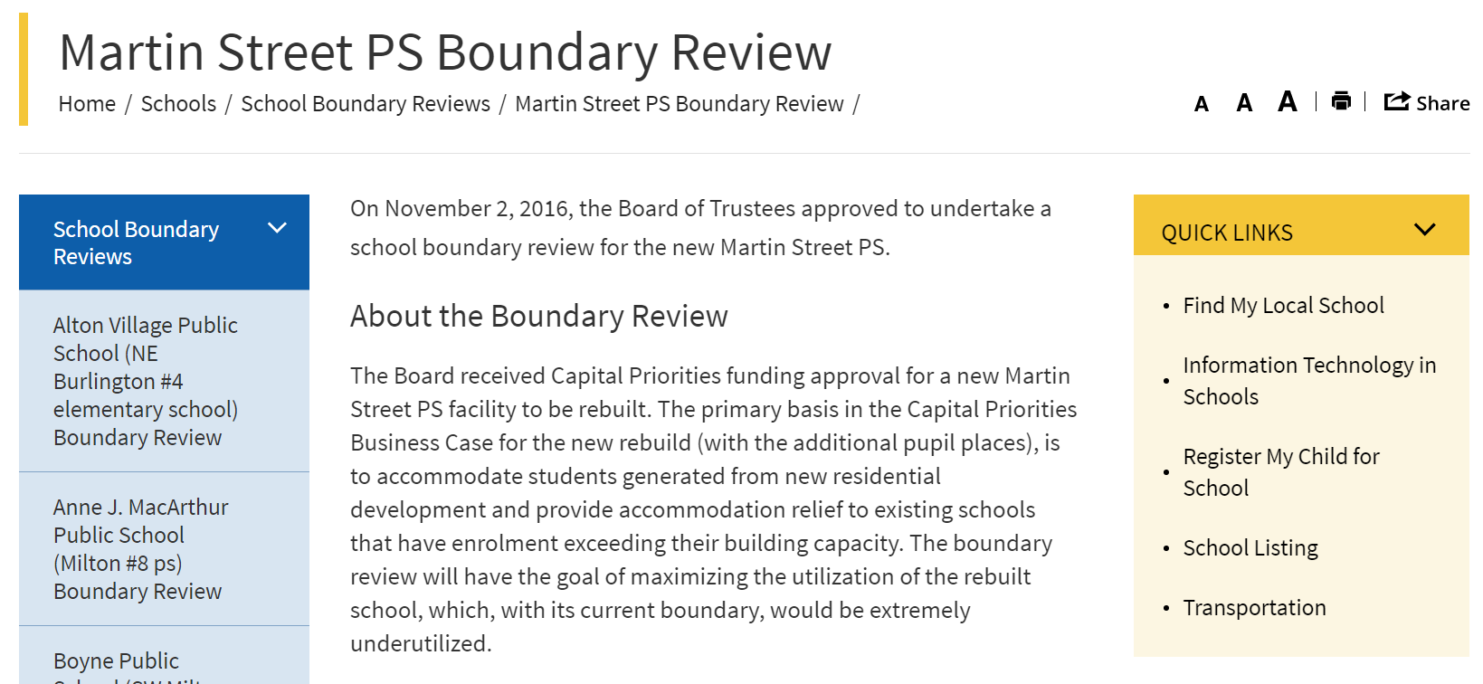
Martin Street BRC

Slide 17
Communication
BRC members - will occur through the HDSB website, FAQs, Meeting Minutes, email to the Chair
Schools/Councils –common school newsletter content, HDSB website, email to inform of community consultation
Community – email at end of process, HDSB website
We will review the need for communication at the end of each meeting and decide upon the content and method

Slide 18
Initial Scenarios and Maps
Guiding Questions
What scenarios do you feel have promise?
What can you offer to make a scenario better?
What scenarios can you NOT live with? Why?
What did we miss (e.g., alternate scenarios)?
Notes:
Dom, Laureen and Mitch

Slide 19
Next Meeting
Tuesday, December 6 (7:00 – 9:00 p.m.)
Milton District High School - Library
BRC Meetings Nov. 24 (7 pm)
Dec. 6 (7 pm)
Dec. 20 (7 pm)
Jan. 10 (7 pm)
Jan. 24 (7 pm)

