Slide 1
Boundary Review Committee Milton #10 Elementary School
Tuesday, December 12, 2017
7:00 pm
Boyne Public School
(Library)

Slide 2
Agenda
Acceptance of notes from November 21 meeting
Purpose and desired outcomes
Transportation Information
Grandparenting Definition
Selection Criteria
New Scenarios
Survey for community - to be sent after public meeting

Slide 3
Purpose of Milton #10 PS
The mandate of the Boundary Review Committee is to determine who will attend the new elementary school in Milton.

Slide 4
Process Goals
That we ensure a process that is fair and transparent
That all members are heard and respected
That our discussions focus on what is best for all students
Our final recommendations will be developed through a consensus process

Slide 5
Transportation Considerations
Proximity to schools (walking distances, safe school routes, natural boundaries)
Cost effectiveness of transportation
Transported and Non-Transported zones within current catchments
The following distances determine eligibility for home to school transportation:
Students in JK to grade 8 are not expected to cross a multi-lane road of more than four (4) lanes without the presence of either an adult crossing guard or traffic signals with a pedestrian crossing signal.

Slide 6
What is Grandparenting?
Grandparenting is a decision to allow existing students of a specific grade(s) in a neighbourhood(s) or geographic area(s) to remain at their current school until they complete a particular grade at that school (e.g., grade 8). This usually occurs in situations where changes to school boundaries have taken place.
When not grandparented, change in boundaries would normally require affected students to change schools.
Students being grandparented are provided transportation subject to the HDSB transportation policies.
Siblings of students that have been grandparented will be directed (unless otherwise stated) to the designated school as per the new approved school boundary.
Students preferring not to be grandparented may apply for Optional Attendance as per the Board’s Administrative Procedure. Historically, the Halton District School Board has made an effort to grandparent students in their graduating year.

Slide 7
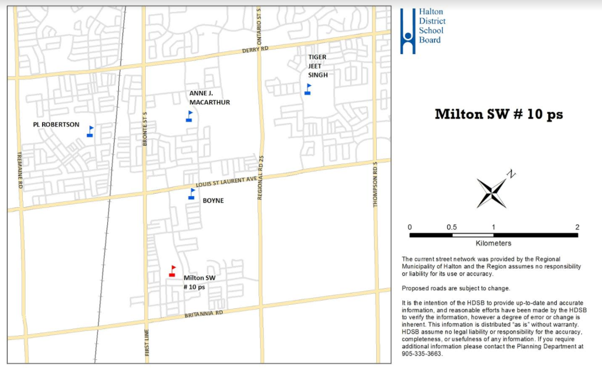
Milton #10 Map

Slide 8
Scenarios and Maps
Guiding Questions
What scenarios do you feel have promise?
1c, 1e, 5 and 8
What can you offer to make a scenario better?
What scenarios can you NOT live with? Why?
New Scenarios
8a, 8b, 8c, 9, 10a, 10b, 11a, 11b

Slide 9
Criteria to Measure Impact & Effectiveness of Boundary Options
Possible criteria could include but is not limited to:
Criteria (could include but should not be limited to the following)
● Viability of Program – How many students are required to offer and maintain program in an educationally sound and fiscally responsible way?
● Proximity to schools -- Are opportunities for walk-to schools being maximized, school routes safe, and natural boundaries incorporated into the proposed options?
● Portables and Portapaks -- Are students being accommodated in permanent facilities and is the use of portable classrooms minimized in the proposed options?
● Balance of overall enrolment -- Is student access to programs, resources and extracurricular opportunities being maximized? Is over and underutilization of buildings avoided to the extent possible?
● Stable, long-term boundaries -- Do the projections show long term stability and result in avoiding the need for additional boundary changes in the short term?
● Transportation -- Does the option demonstrate cost effective transportation?
● Fiscally Responsible -- Does the option strive to reduce unnecessary costs?
● Student Experience -- Does the option demonstrate an effort to reduce the number of school moves students have experienced? Are cohorts kept together?
● Other -- Any other criteria recommended by the Boundary Review Steering Committee or Boundary Review Committee

Slide 10
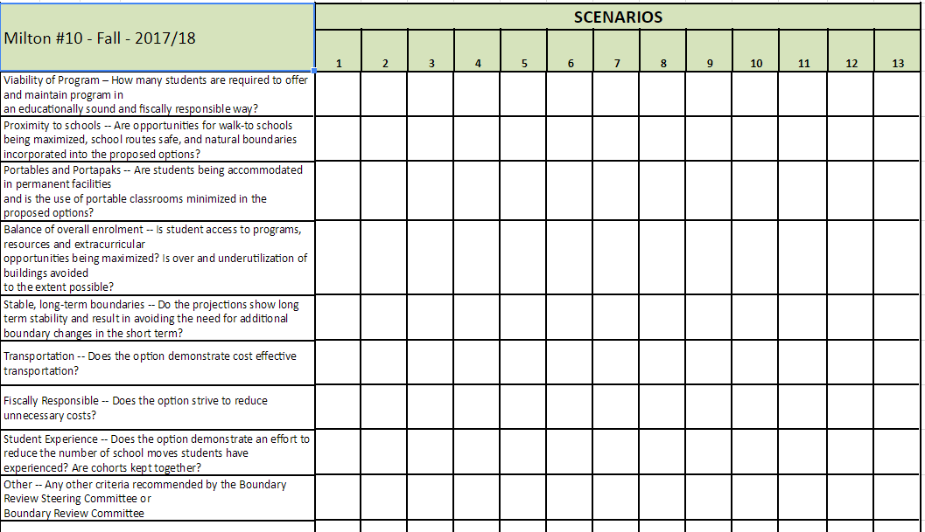

Slide 11
Public Survey
Survey - Thanks Mitch!

Slide 12
Open House
Format of the evening
Volunteer - 2 min - parent perspective of process
Thanks Ian!

Slide 13
Communication
BRC members - will occur through the HDSB website, FAQs, Meeting Minutes, email to the Chair
Schools/Councils –common school newsletter content, HDSB website, email to inform of community consultation
Community – email on December 22 -Public Meeting

Slide 14
Next Meeting
Tuesday, November 7 (7:00 – 9:00 p.m.)
Boyne Public School - Library
BRC Meetings Oct. 24 (7 pm)
Nov. 7 (7 pm)
Nov. 21 (7 pm)
Dec. 12 (7 pm)
January 9 (7 pm) - PM
Jan. 16 (7 pm)

